Slide 1

Big Mart Sales Prediction
Madhur Dukhande (20104014)
Manashree Chavan (20104028)
Aryan Amin (20104071)
Mayur Jain (20104024)
Project Guide
Ms. Rujata Chaudhari
Notes:
1

Slide 2
Contents
Introduction
Objectives
Scope
Literature Survey
Proposed System
Project Outcomes
Block Diagram
Use Case/DFD
Technology Stack
Suggestions in Review-1
Result and Discussion
Conclusion and Future Scope
References
Notes:
2

Slide 3
1. Introduction
Big Mart is a large retail chain that operates in various cities across the world. The company deals in a variety of products ranging from food to household items.
Problem Identified :
Big Mart faced challenges in accurately predicting the sales of its products, which led to issues such as overstocking or understocking of products in their stores.
Solution Proposed :
Accurate sales forecasting using machine learning, leveraging historical sales data and other relevant factors, leading to reduced wastage and lost revenue.
Optimal pricing strategies based on demand, competition, and other factors, leading to increased competitiveness in the market.
Notes:
3

Slide 4
2. Objectives
To Predict future sales from a given dataset.
To provide the key features that are responsible for the sale of a particular product
To Find the best algorithm that will predict sales with the greatest accuracy.
To provide an easy to use interface to access the prediction of sales.
Notes:
4

Slide 5
3. Scope
Can focus on predicting sales for specific product categories.
2. Can utilize advanced machine learning techniques.
3. Can Provide a user interface that allows users to input data about their products and sales.
4. Can Expand the project to other geographic regions.
Notes:
5

Slide 6
4.Literature Survey
Sr.no | Title | Author(s) | Year | Algorithm | Limitations | Result
1 | Sales Prediction using machine learning | K.Saraswati, P.Naveen | 2021 | -Random Forest Regression -Multiple Linear Regression | Linear Regression is very famous for prediction but it gives less accuracy.. | Accurate projections make it easier for the shop to boost demand growth and a higher degree of sales generation.
2 | Big Mart Sales prediction using Machine learning | Kopilaka Rajesh, V.Prabhakar, Bhuvya Klayan | 2022 | -XG Boost algorithm | Only one algorithm used, whereas all other algorithms could have made it better | When the user submits details of a particular item, the system will predict sales generated by that item.
3 | Big Mart Sales using machine learning with data analysis | Asha Jyoti Kalluri, Arun Kumar, Aishwarya Poojari | 2020 | -XGBoost -Decision Tree | insufficient data to accurately predict sales, the models performance may be compramised | The Machine Learning Methods will help to select the most suitable demand prediction algorithm which will prepare its marketing campaigns.

Slide 7
5. Proposed System
Feature 1 :
Historical sales data: Big mart can use past sales data to predict future sales. This can be done by analyzing sales trends, seasonality, and patterns to identify potential sales opportunities and challenges.
Feature 2 :
Product inventory: Big mart can use inventory data to identify which products are selling well and which ones aren't. This information can be used to optimize product mix and stocking levels to maximize sales potential.
Notes:
7

Slide 8
6. Algorithm used
Random forest regression: Random forest regression is a machine learning algorithm that uses multiple decision trees to make predictions on numerical data. It reduces overfitting by using random subsets of features and training data, and improves accuracy by combining the predictions of individual trees.
Linear regression: Linear regression is a statistical method that models the relationship between a dependent variable and one or more independent variables by fitting a straight line to the data. It is used for predicting numerical values and identifying the strength and direction of the relationship between variables.

Slide 9
7. Outcome of Project
1. User will be to access sales prediction number with an easy to use interface.
2. User will able to access the visualized charts of predicted sales
User can get the sales of predicted data by having to filter the item information by accessing the surveyed data.
Users will be able to check whether the sales of a item has increased or decreased ,thus can get the products accordingly.
Notes:
9

Slide 10
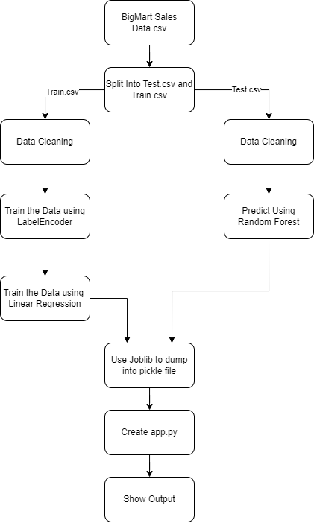
8. Block Diagram
Notes:
10

Slide 11

8. DFD Level 0:

Slide 12
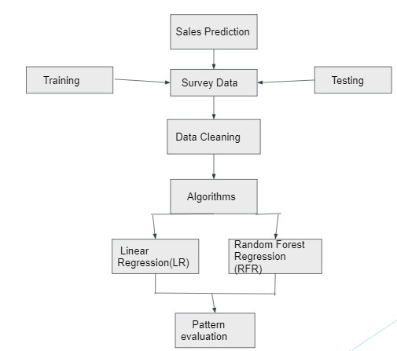
Level 1:

Slide 13
9. Technology Stack:
FontEnd: HTML, CSS
BackEnd: python
IDE : VS Code
Algorithm: Random Forest Regression, Linear Regression
Notes:
13

Slide 14
9. Suggestions in Review-1
Scope : technical, domain specific
Literature survey :2020,
Paper title,
Findings,
Usage.
3. After proposed system write algorithms used.
4. Outcome : photos of GUI and all.
5. Result and discussion on next presentation
6. Future scope: keep only bold one

Slide 15
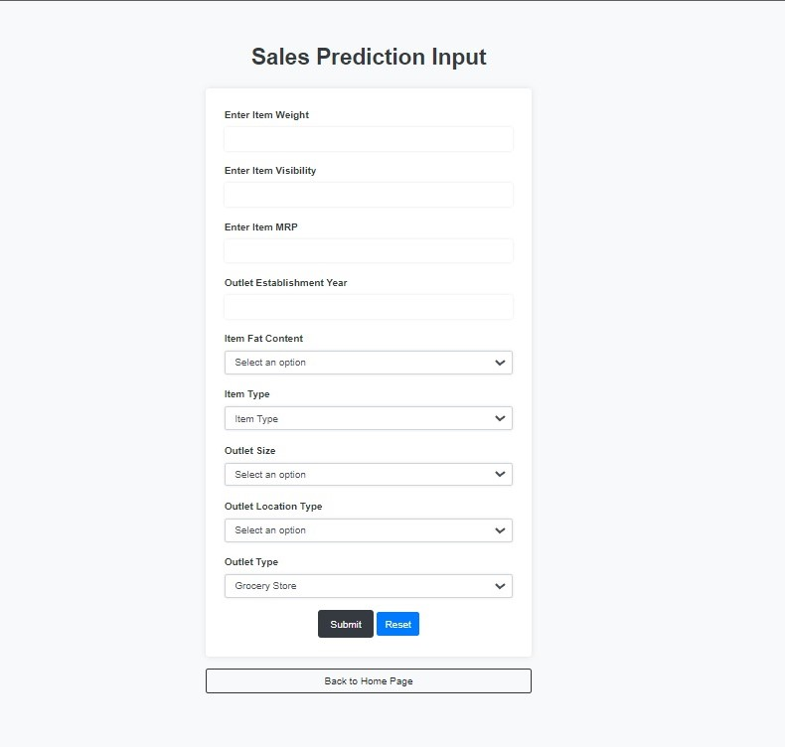
10.Result and Discussion

Slide 16
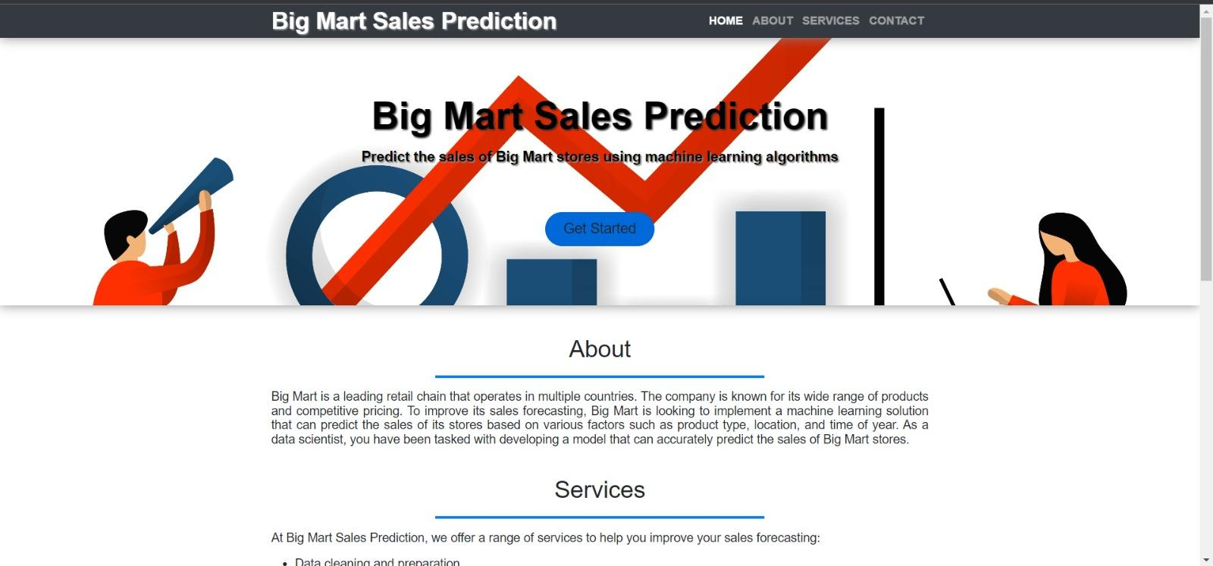
10.Result and Discussion

Slide 17
11. Conclusion & Future Scope
Conclusion:
Our predictions help big marts to refine their methodologies and strategies which in turn helps them to increase their profit . The results predicted will be very useful for the executives of the company to know about their sales and profits.
Future Scope:
Integration with other data sources: The Big Mart sales prediction system can be improved by integrating with other data sources, such as social media and weather data, to help predict trends and better understand consumer behavior.
Real-time updates: The system can be improved to provide real-time updates of sales predictions, which will help managers make timely decisions about inventory management, pricing strategies, and promotions.

Slide 18
References
1. Rohit Sav, Pratiksha Shinde, Saurabh Gaikwad (2021, June). Big Mart Sales Prediction using Machine Learning.2021 International Journal of Research Thoughts (IJCRT).
2. Heramb Kadam, Rahul Shevade, Prof. Deven Ketkar , Mr. Sufiyan Rajguru (2018). A Forecast for Big Mart Sales Based on Random Forests and Multiple Linear Regression. (IJEDR).
3. Gopal Behere, Neeta Nain (2019). Grid Search Optimization (GSO) Based Future Sales Prediction for Big Mart. 2019 International Conference on Signal-Image Technology & Internet-Based Systems (SITIS).
4. Archisha Chandel, Akanksha Dubey, Saurabh Dhawale, Madhuri Ghuge (2019, April). Sales Prediction System using Machine Learning. International Journal of Scientific Research and Engineering Development.

Slide 19
Thank You...!!
Notes:
19

